Slide 1
The Virtues of Administration:
Values and the Practice of Public Service
Anthony D. Molina, Cleveland State University
Article in Administrative Theory & Praxis · March 2015 –
Public values are defined as those values that provide normative consensus about:
1- the rights, benefits, and prerogatives to which citizens should (and should not) be entitled;
2- the obligations of citizens to society, the state, and one another; and
3- the principles upon which governments and policies must be based.

Slide 2
Public values have been central to public administration over the years and the key public values are equity, impartiality, justice, honesty, fairness, probity, continuity, secrecy, accountability, transparency, responsiveness, and so on. However, the significance of public values is said to have declined in recent years. Some scholars warn us about the emerging problem of ‘public-value failure’ because public-value failure occurs when:

Slide 3
Public-value failure
(1) mechanisms for the articulation and aggregation of values have broken down;
(2) ‘imperfect monopolies’ occur;
(3) benefit hoarding occurs;
(4) there is a scarcity of providers of public value;
(5) a short time horizon threatens public value;
(6) a focus on substitutability of assets threatens conservation of public resources; and
(7) market transactions threaten fundamental human subsistence.

Slide 4
mechanizmy artykulacji i agregacji wartości uległy awarii;
(2) występują „niedoskonałe monopole”;
(3) zachodzi gromadzenie świadczeń;
(4) występuje niedobór dostawców wartości publicznej;
(5) krótki horyzont czasowy zagraża wartości publicznej;
(6) koncentracja na substytucyjności aktywów zagraża ochronie zasobów publicznych; oraz
(7) transakcje rynkowe zagrażają fundamentalnej egzystencji ludzi.

Slide 5
The Virtues of Administration
Virtues may be thought of as qualities that prompt individuals to act in ways that are appropriate within the context of particular situations. Importantly, this virtuous intermediate state is always situated within a particular context, and will therefore manifest itself differently depending upon the details of the situation. The manner in which is used humor during a job interview, for example, will differ from the manner in which is used humor with children or with friends.

Slide 6
It consists in developing an appropriate feeling, or intuitive sense, for taking the right action “at the right time, about the right things, toward the right people, for the right end, and in the right way”.
Polega ona na rozwijaniu odpowiedniego poczucia, czyli intuicji, do podejmowania właściwych działań “ we właściwym czasie, w sprawie właściwych rzeczy, wobec właściwych ludzi, we właściwym celu i we właściwy sposób”.

Slide 7
We acquire virtues through education, habit, and by observing and modeling the ethical behavior of others. Thus, we become just by doing just actions, temperate (umiarkowany) by doing temperate actions, brave by brave actions.
The main point here is that the manner in which we acquire virtues, and the contextual nature in which they are exercised, makes virtue ethics a particularly helpful way of thinking about public service values.
A virtue is a disposition to act in a particular way that becomes manifest in the form of attitudes, skills, and behaviors. Courage, for example, consists in a disposition to courage, but also in acting courageously.

Slide 8
Like virtues, public service values are acquired over time through education, modeling, and habit, and are useful for achieving some end, or set of ends. The contextual grounding for these attitudes, skills, and behaviors is the “practice”.
A practice that means any coherent and complex form of socially established cooperative human activity through which goods internal (public interest) are realized achieveing a standards of excellence.

Slide 9
Public administration may also be conceptualized as a practice, and was described as a “socially embedded process of collective relationships, dialogue, and action in pursuit of human flourishing for all”.
Such a conceptualization is useful because, rather than narrowly focusing on governmental structures, institutions, or individual actors, it draws our attention to the broader social and cooperative aspects of public administration practice, as well as the goods and ends to which they are directed.

Slide 10
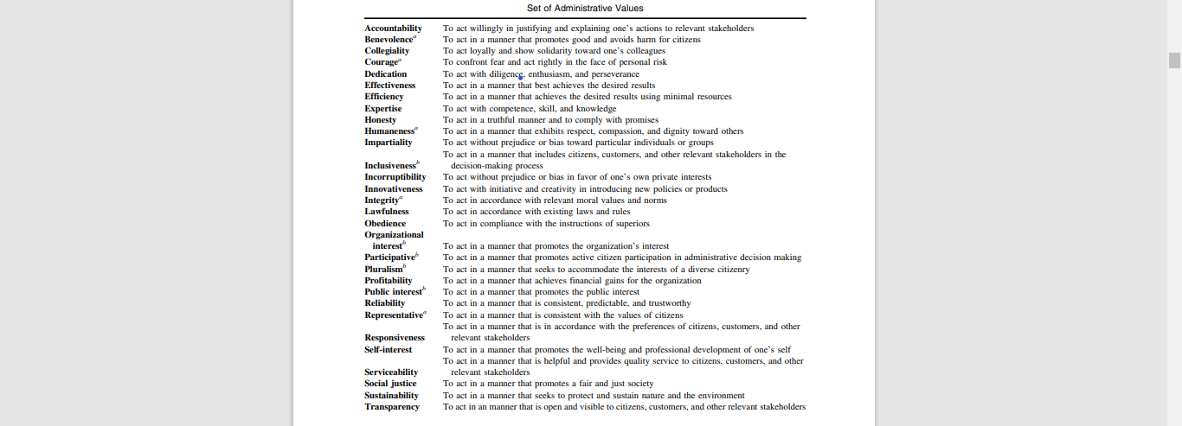

Slide 11
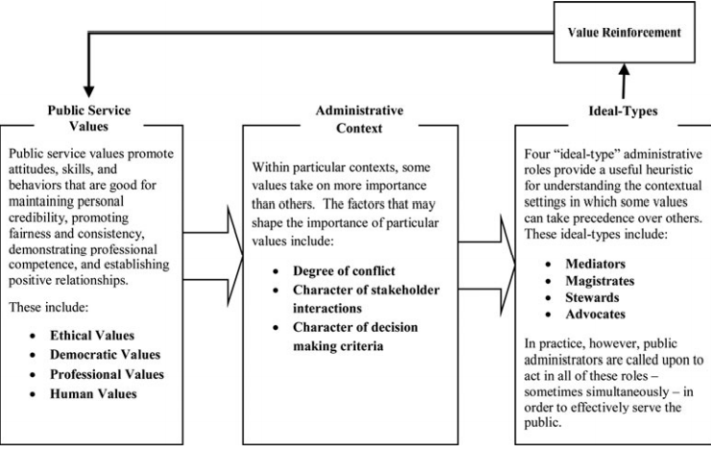
Model of public service practice

