Slide 1
Virtues (cnoty) in the public administration and the relations with the public
What place for virtues in public administration?
On the base of the work:
Fabrice Larat: Quelle place pour les vertus dans l’administration publique ?
Revue internationale d’ethique societale et gouvernementale
Vol. 15, n ° 2 - 2013
https://journals.openedition.org/ethiquepublique/1301

Slide 2
Introduction
Some concepts have the particularity of appearing both familiar and far removed from reality and current concerns. While the notions of trust, integrity and accountability seem obvious, especially when presented as remedies for the ills from which many institutions and public administrations suffer, the notion of virtue seems to refer to an obsolete, not to say historically outdated, conception of the functioning of societies in general and of public affairs in particular, and this, much more than that of ethics which, because of its philosophical connotation, would be a priori more timeless.

Slide 3
Why then wonder about the place occupied nowadays by virtues in public administration?
The answer to this question is to be found in the link between individual behavior and collective behavior and in what makes the junction between, on the one hand, the existence of rules and principles necessary for good governance and, on the other hand on the attachment of the individuals who make the public administration function to these same values and principles. So these principles and values do not remain abstract and formal concepts but are reflected in behaviors and attitudes corresponding to ethical and deontological (Deontology: a theory that suggests actions are good or bad according to a clear set of rules) requirements that we are entitled to have towards public officials.

Slide 4
What is Virtue Ethics?
Contemporary virtue ethics is an updated version of a theory first proposed in ancient Greece. Today’s proponents acknowledge that it’s very difficult to set up a list of moral rules that are going to solve ethical dilemmas across cultural lines. Typically, they don’t go quite so far as the culturalists; they don’t believe that basic regulations of right and wrong are completely independent from one community to another.
In practical terms, however, there’s agreement that the world is too diverse and changing to be controlled by lists of recommendations and prohibitions.

Slide 5
So proponents of virtue suggest that we change the focus of our moral investigations. Instead of trying to form specific rules for everyone to follow : don’t bribe, don’t exploit people, they propose that we build virtuous character. The idea is that people who are good will do the good and right thing, regardless of the circumstances : whether they’re at home or abroad, whether they’re trying to win new clients or making a decision about what kind of images are appropriate for public.

Slide 6
Definitions
Cambridge Dic,
a good moral quality in a person, or the general quality of being morally good: Patience is a virtue.
Merriam wedster, 1a : conformity to a standard of right : morality. b : a particular moral excellence.
2 : a beneficial quality or power of a thing. 3 : manly strength or courage : valor.
Vocabulary.com,
The word virtue comes from the Latin root vir, for man. At first virtue meant manliness or valor, but over time it settled into the sense of moral excellence. Virtue can also mean excellence in general. One of your virtues might be your generous willingness to help out your friends.

Slide 7
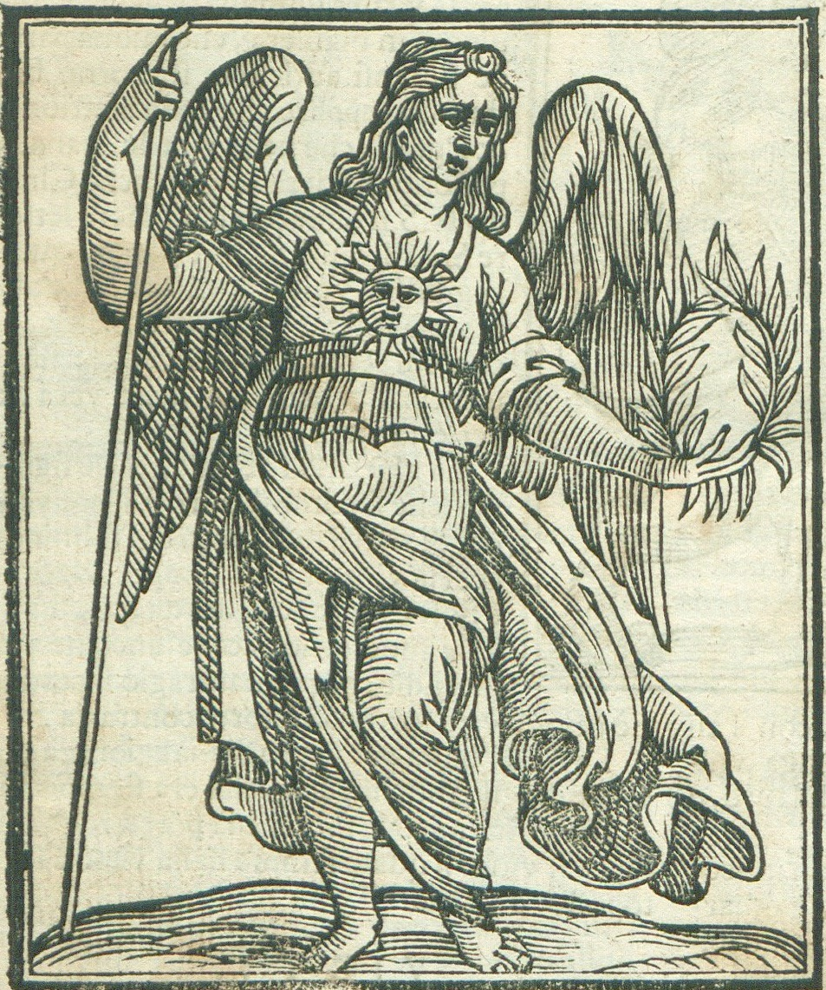
Cnota
Cnota : ugruntowana, stała etyczna dyspozycja
człowieka gotowego posługiwać się swoimi
władzami moralnymi – rozumem, wolą
i zmysłami – do postaw i konkretnych czynów
zgodnych z dobrem etycznym.
Cnota jest trwałą sprawnością moralną osoby,
dzięki której przestrzeganie zasad moralnych
staje się łatwe.
Uosobienie cnoty, ilustracja z Ikonologii Cesare Ripy,
Wenecja 1669; Biblioteka Narodowa

Slide 8
Civic virtues in a changing World
[ Cnoty obywatelskie w zmieniającym się świecie ]
Generally, it is agreed that virtues are firm attitudes guiding individual conduct that result in a stable disposition to perform a specific type of moral act. Because of its polysemy, the concept of virtue can refer both to the virtue of the good man or to that of the citizen, that is to say, according to the distinction proposed by Aristotle, to a absolute virtue or to a virtue relating to a constitution.

Slide 9
It is for this reason that political theory has emphasized the importance of virtues and their dissemination for the life of the city. In the eighteenth century, Montesquieu declared in the ″De l’esprit des lois″, in Chapter III of Book III devoted to the principle of democracy, that it does not take a lot of probity for a monarchical government or a despotic government (absolute and arbitraży) to be maintained or to be sustained: ”The force of the laws in one, the prince's arm always raised in the other, regulate and contain everything″.

Slide 10
But in a popular state, one more mechanism is needed, which is virtue. Later, in Chapter XVIII of Book V, he adds that in a republic where virtue reigns, the State only rewards by testifying to this virtue.
In the extension of ancient thought, among the various existing virtues, we can distinguish four having particular qualities and therefore playing a pivotal role in human action and which are qualified as cardinal.

Slide 11
The first, called ″Prudentia, ostrożność ″, that is to say prudence, combines strength of mind and the faculty of discernment allowing in all circumstances to distinguish the true good and to choose the right means to accomplish it. Both intellectual and moral, prudence denotes a practical wisdom which disposes reason to the knowledge of the truth in the conduct of life;

Slide 12
The second called ″Temperentia, wstrzemięźliwość″, or temperance, ensures the mastery of the will over the instincts and allows us to discipline our desires and our passions;
Strength, or courage ″Fortitude″, enables one to stand firm in adversity and steadfast in the pursuit of good, to resist temptations and to overcome obstacles in the moral life;
The last of these cardinal virtues, ″Iustitia″, justice, it consists in the constant and firm will to give morally to each one what is universally due to him.

Slide 13
For Neo-Platonic philosophers like Plotinus and Porphyry
The traditional distinction between different virtues only reflects the different modes of exercise that can be observed depending on the level at which they manifest themselves and depending on the different possible fields of application.
Among the different forms of virtues, they thus distinguish what they call civic virtues, that is to say those which regulate the affections of human beings and their conduct in social life.

Slide 14
It is these virtues that aim to allow a life in common that is not a source of disadvantage for the members of the group, while ensuring the cohesion of the community. They contribute to the moderation of the passions of citizens, and they can be achieved by obeying what reasoning considers to be its duties and by conforming to them in its actions.

Slide 15
Because they combine the main aspects of individual and collective action, civic virtues make possible to fulfill in the field of public administration the highest ethical requirements which flow from the founding standards and principles of action. that are the search and preservation of the general interest, impartiality, personal disinterestedness, integrity and probity (honesty), as well as dedication to the public cause.

